Slide 1
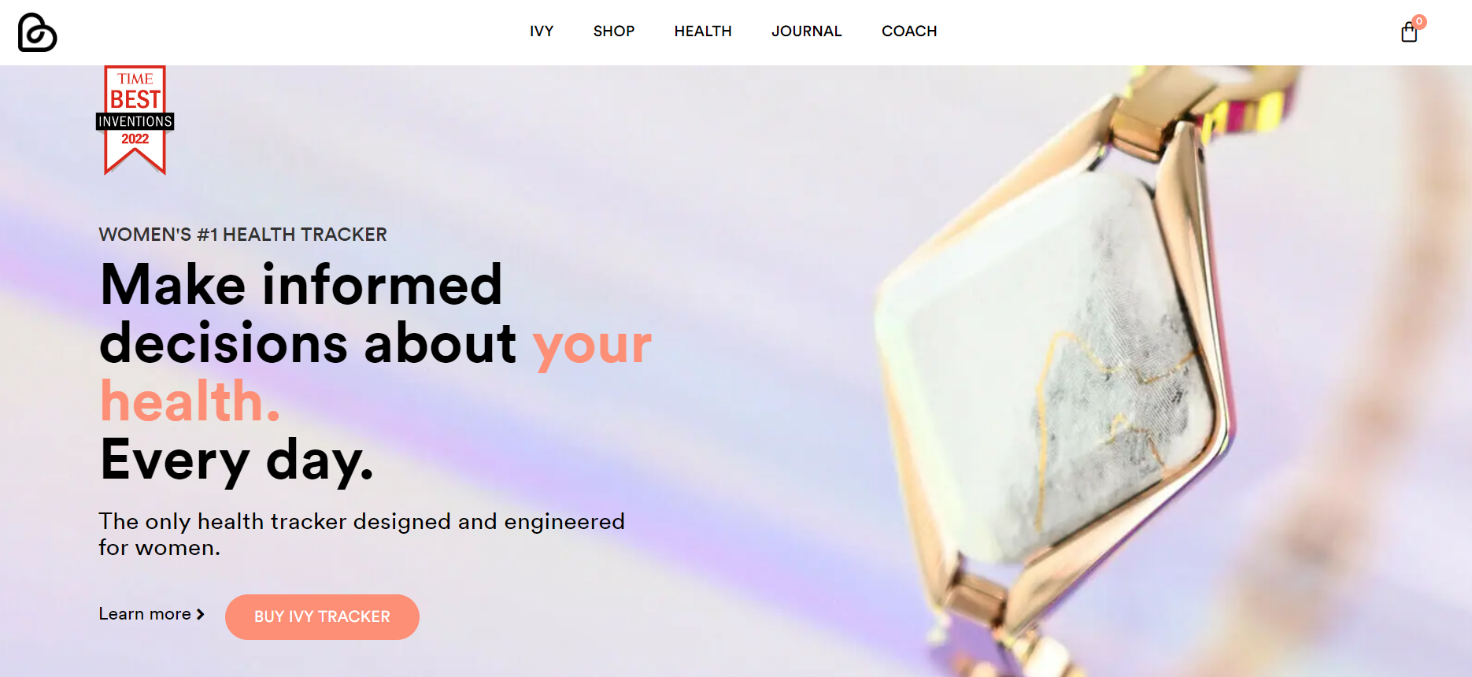

Google Data Analytics Capstone Project: Case Study
Case Study : How Can a Wellness Technology Company Play It Smart?
Tool Used: MS Excel

Slide 2
Agenda
Project Background
Methodology
Insights
Recommendations

Slide 3
Project Background: Bellabeat
High Tech smart device company
Focused on women
Their products track: Physical Activities, Sleep pattern, Heart rate etc.

Slide 4
Objective/Tasks:
Grow and become a larger player in the smart device industry
Trends in FitBit Smart device usage
How the trends can be applied to Bellabeat Customers
How it will help marketing strategy for any Bellabeat product.

Slide 5
Methodology:
**DATA SOURCE** [FitBit Fitness Tracker data]
Link: https://www.kaggle.com/datasets/arashnic/fitbit
The data is collected from 30 users of the Fitabase Products.
Columns highlighted in the dataset: User_Id, ActivityDates, TotalDistance, TotalSteps, VeryActiveDistance, SleepDay, Calories etc.

Slide 6
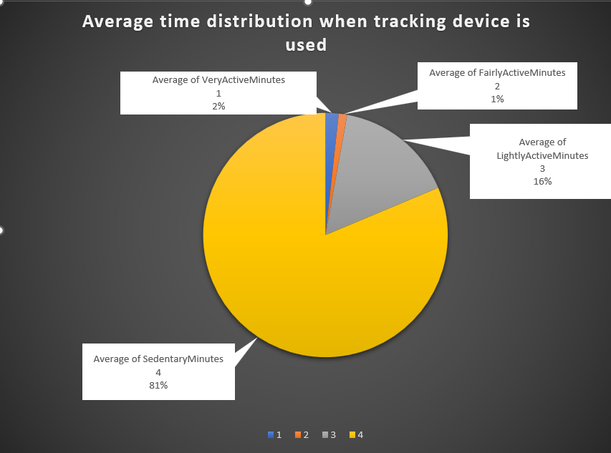
Insights:
100% tracked physical activities like calories burned, steps etc.

Slide 7
Recommendations:
Health devices for everyday use
Health campaigns
Advertising slots
Unique offerings like sleep reminders, reward system etc

